Slide 1

Introduction
Sai Pattapu(16326521)
Komal Vanamala(16326400)
Kishore Yellu(16326617)
Chandra sekhar Challa(16321386)
Jaya Dharani Merla(16321391)
Harsha Vardhan Nadupalli(16327438)
Rohit Roy Yakkati(16321868)
Udiptaman Das(16340325)
Comp_Sci-5590, Special Topics,IOT_ Embedded Systems

Slide 2

Agenda
Goal: The goal of this system is to monitor the activity levels of elderly individuals and their movements.
To achieve this, we placed a series of IoT sensors throughout the elderly individual's living space. These sensors can detect movement of aged persons.
When an elderly individual needs assistance, the sensors will detect this and send an alert to their caregiver by an email.
The system can also be programmed to detect specific events, such as a fall or prolonged inactivity. This allows caregivers to respond quickly and provide assistance when needed.
Our project has the potential to improve the quality of life for elderly individuals and their caregivers.

Slide 3
Introduction
IOT- based Elderly Activity Monitoring System
As the world's population continues to age, there is a growing need for technologies that can help elderly individuals maintain their independence and stay safe. Our project addresses this need by developing an IoT-based monitoring system that can track activity levels
In this presentation, we will provide an overview of our project, including the problem we are addressing, our approach to solving it, and the technologies we used. We will also share some of our results and discuss the implications of our work.

Slide 4
ESP 32 Microprocessor
The ESP32 is a powerful microcontroller that features built-in Wi-Fi and Bluetooth connectivity.
It also features touch sensors, an accelerometer, and a temperature sensor, providing additional capabilities for sensor-based projects.
The ESP32 supports Arduino IDE, making it easy to develop and program.
The ESP32 can be powered by a wide range of voltage inputs, including 3.3V, and 5V..
It is available in a variety of packages, including surface mount and through-hole, allowing for easy integration into different designs.

Slide 5
Ultrasonic Sensor
An ultrasonic sensor uses sound waves to measure distance, obstacle detection, presence, or proximity of an object
It emits high frequency sound waves (ultrasound) and then listens for the echo that bounces back from an object
The time between sending the sound wave and receiving the echo is used to calculate the distance to the object
They are relatively inexpensive and easy to use, with many readily available commercially available options
However, they can be affected by ambient noise, temperature, and humidity, which can affect their accuracy and reliability.

Slide 6
Procedure
Connect the ultrasonic sensors to the ESP32 microprocessor: Connect the VCC and GND pins of each ultrasonic sensor to the power and ground rails of the breadboard.
Then connect the trigger and echo pins of each sensor to different GPIO pins on the ESP32 microprocessor.
Set up the Arduino IDE: Install the ESP32 board package in the Arduino IDE and select the correct board and port.
Write the code to read the sensor data and send it to a cloud-based platform.
Analyze and display data: Use a dashboard or visualization tool to analyze and display the data collected from the sensors. This can help caregivers and family members monitor the activities of the elderly person.
Set up alerts: Use the sensors to set up alerts that notify caregivers or emergency services if the elderly person falls or experiences a medical emergency.
This is a general procedure for building an IoT-based elderly activity monitoring system using 4 ultrasonic sensors, Arduino IDE, and ESP32 microprocessor.
Sensors alerts can be connected to your mobile via ThingSpeak IoT platform.
Apparatus: We have 4 ultrasonic sensors, an ESP32 microprocessor, a breadboard, jumper wires, a power supply, and a computer with Arduino IDE installed.

Slide 7
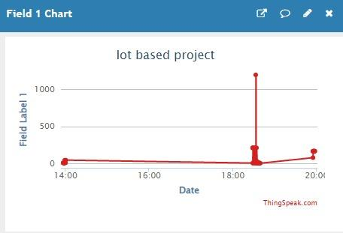

Slide 8
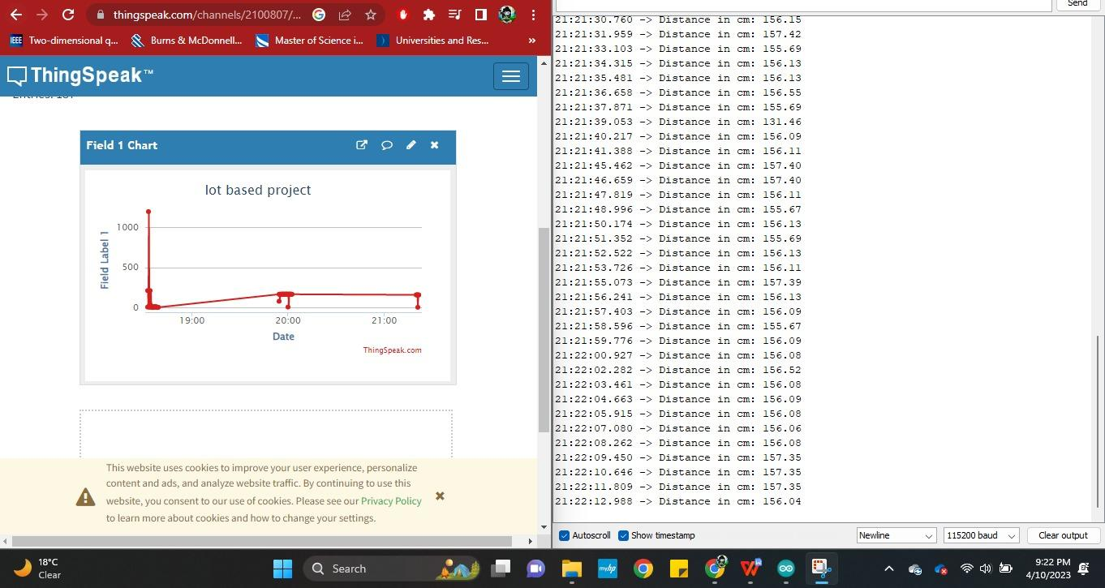

Slide 9
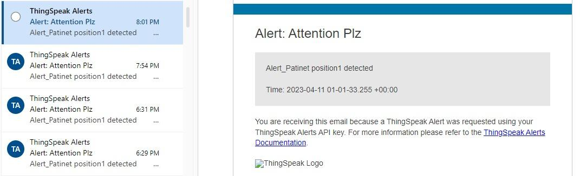

Slide 10
Understanding and Conclusion
In conclusion, our IoT-based elderly activity monitoring system has the potential to revolutionize the way we care for elderly individuals. By using IoT sensors to monitor activity levels. we can provide better care and ensure that elderly individuals can maintain their independence for as long as possible.
Our system is designed to be easy to install and use, and can be customized to fit the specific needs of individual caregivers. With the ability to detect specific events such as falls or prolonged inactivity, our system allows caregivers to respond quickly and provide assistance when needed.

Slide 11
THANK YOU

